Slide 1
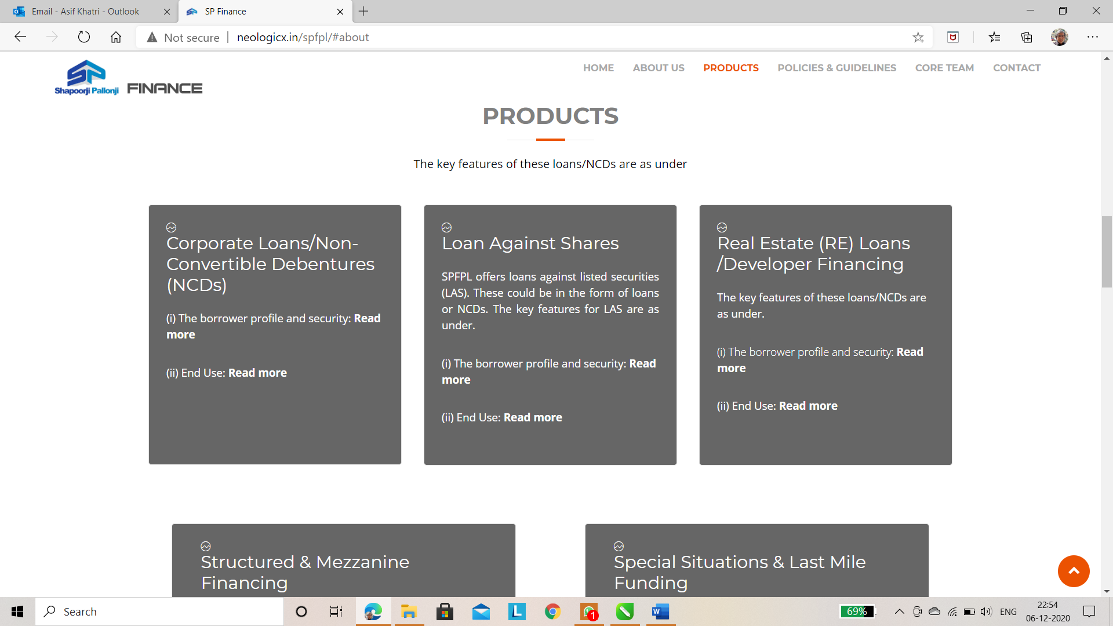
Delete this. This is the headline copy of Corporate Loans / Non-Convertible Debentures (NCDs)

Slide 2
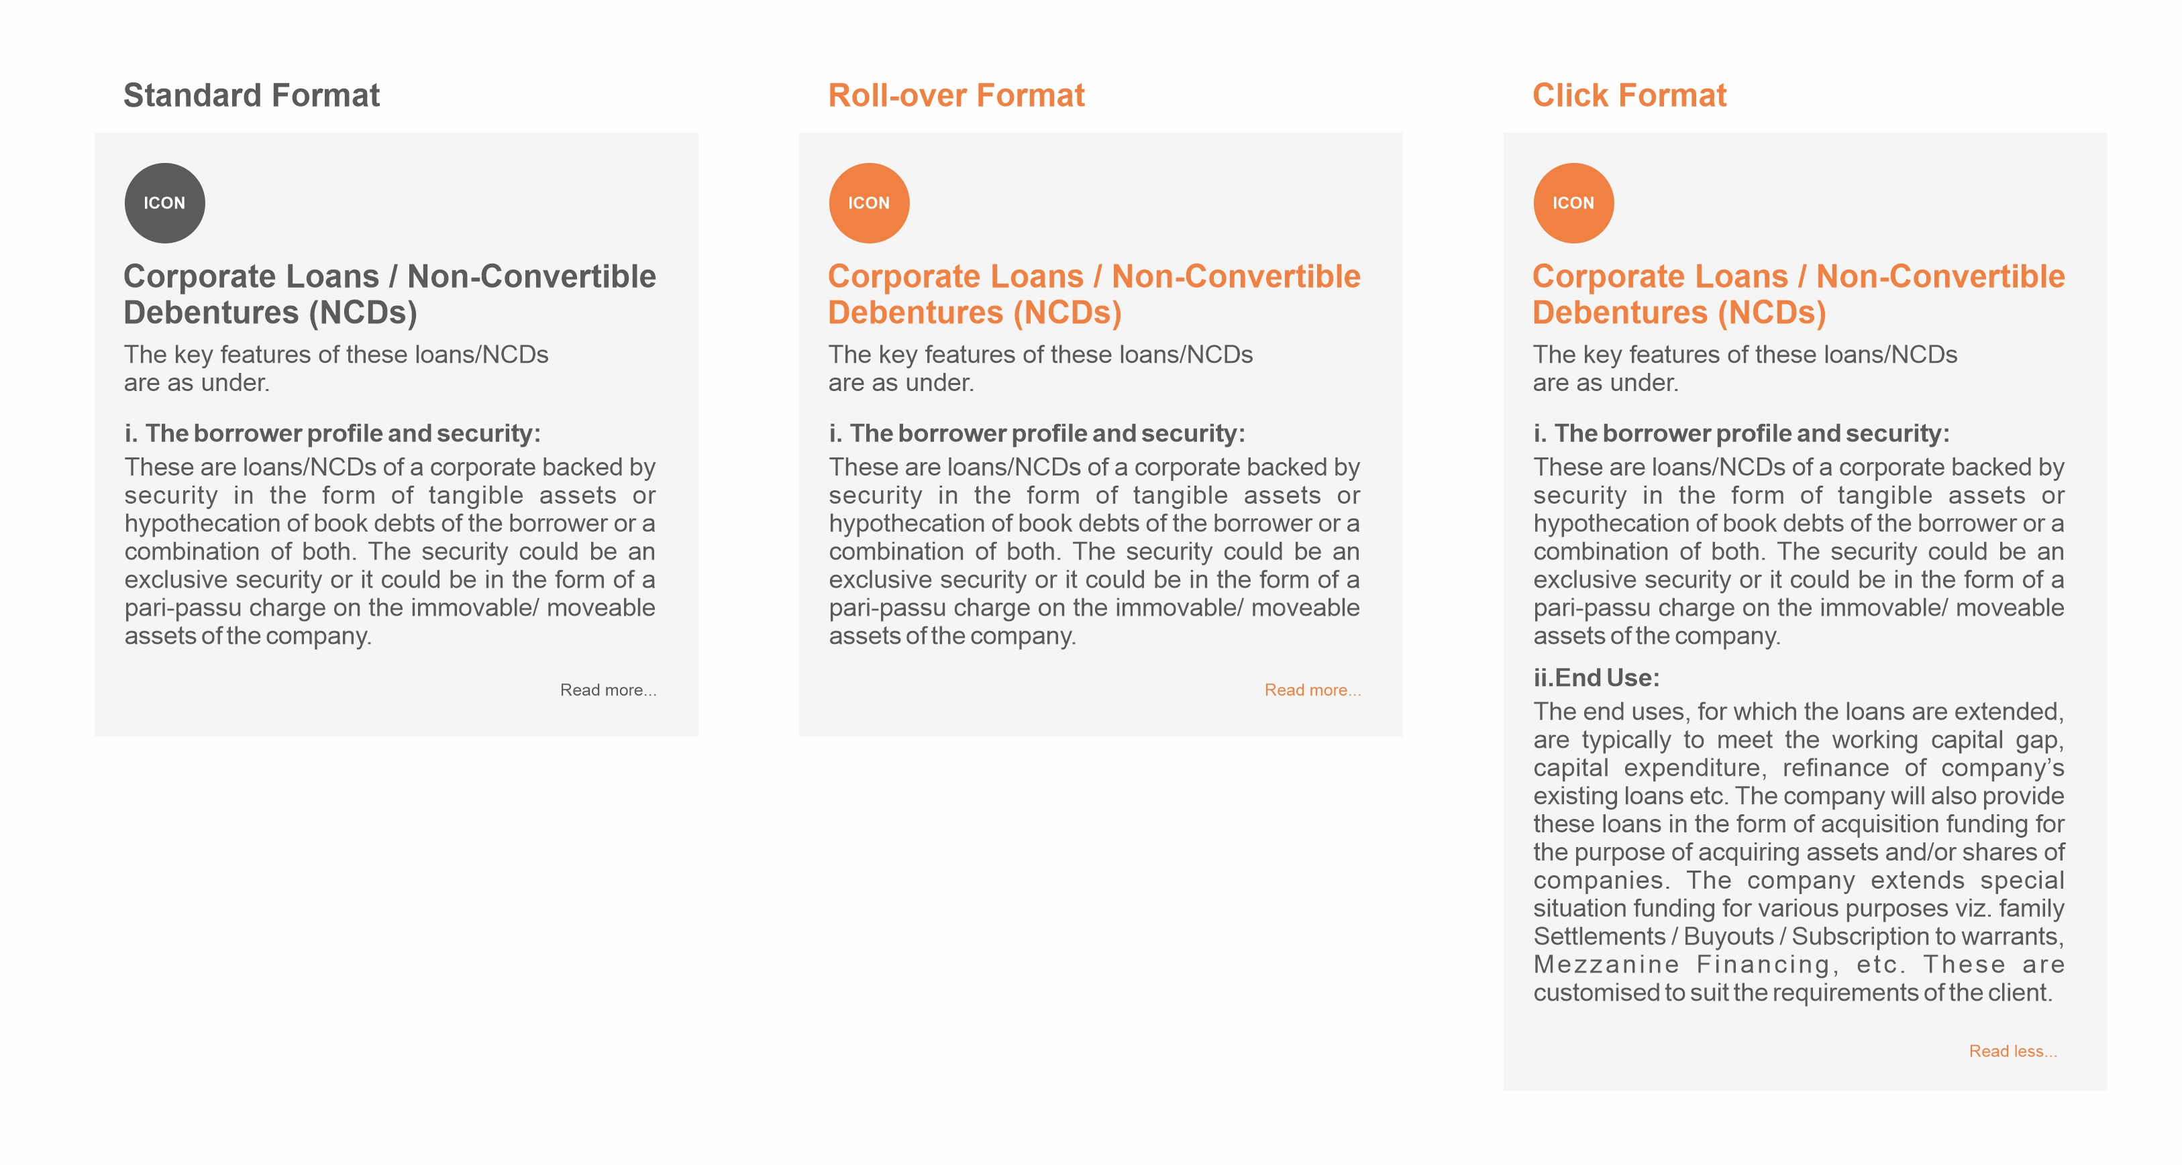
Note:
Kindly use a light gray background for all boxes but 10% darker than the base page colour. For example, if the base page colour is 10% Black, then the boxes colour will be 20% Black.
Kindly use ‘ICON’ which will relate to the respective financing option.
When other product is clicked, the previously clicked product should automatically return to its standard condition.
There will be only one ‘Read more…’ in each product box.
When ‘Read more…’ is clicked, the ‘Read less…’ button/text should appear after and below the end of the respective product’s content.

Slide 3
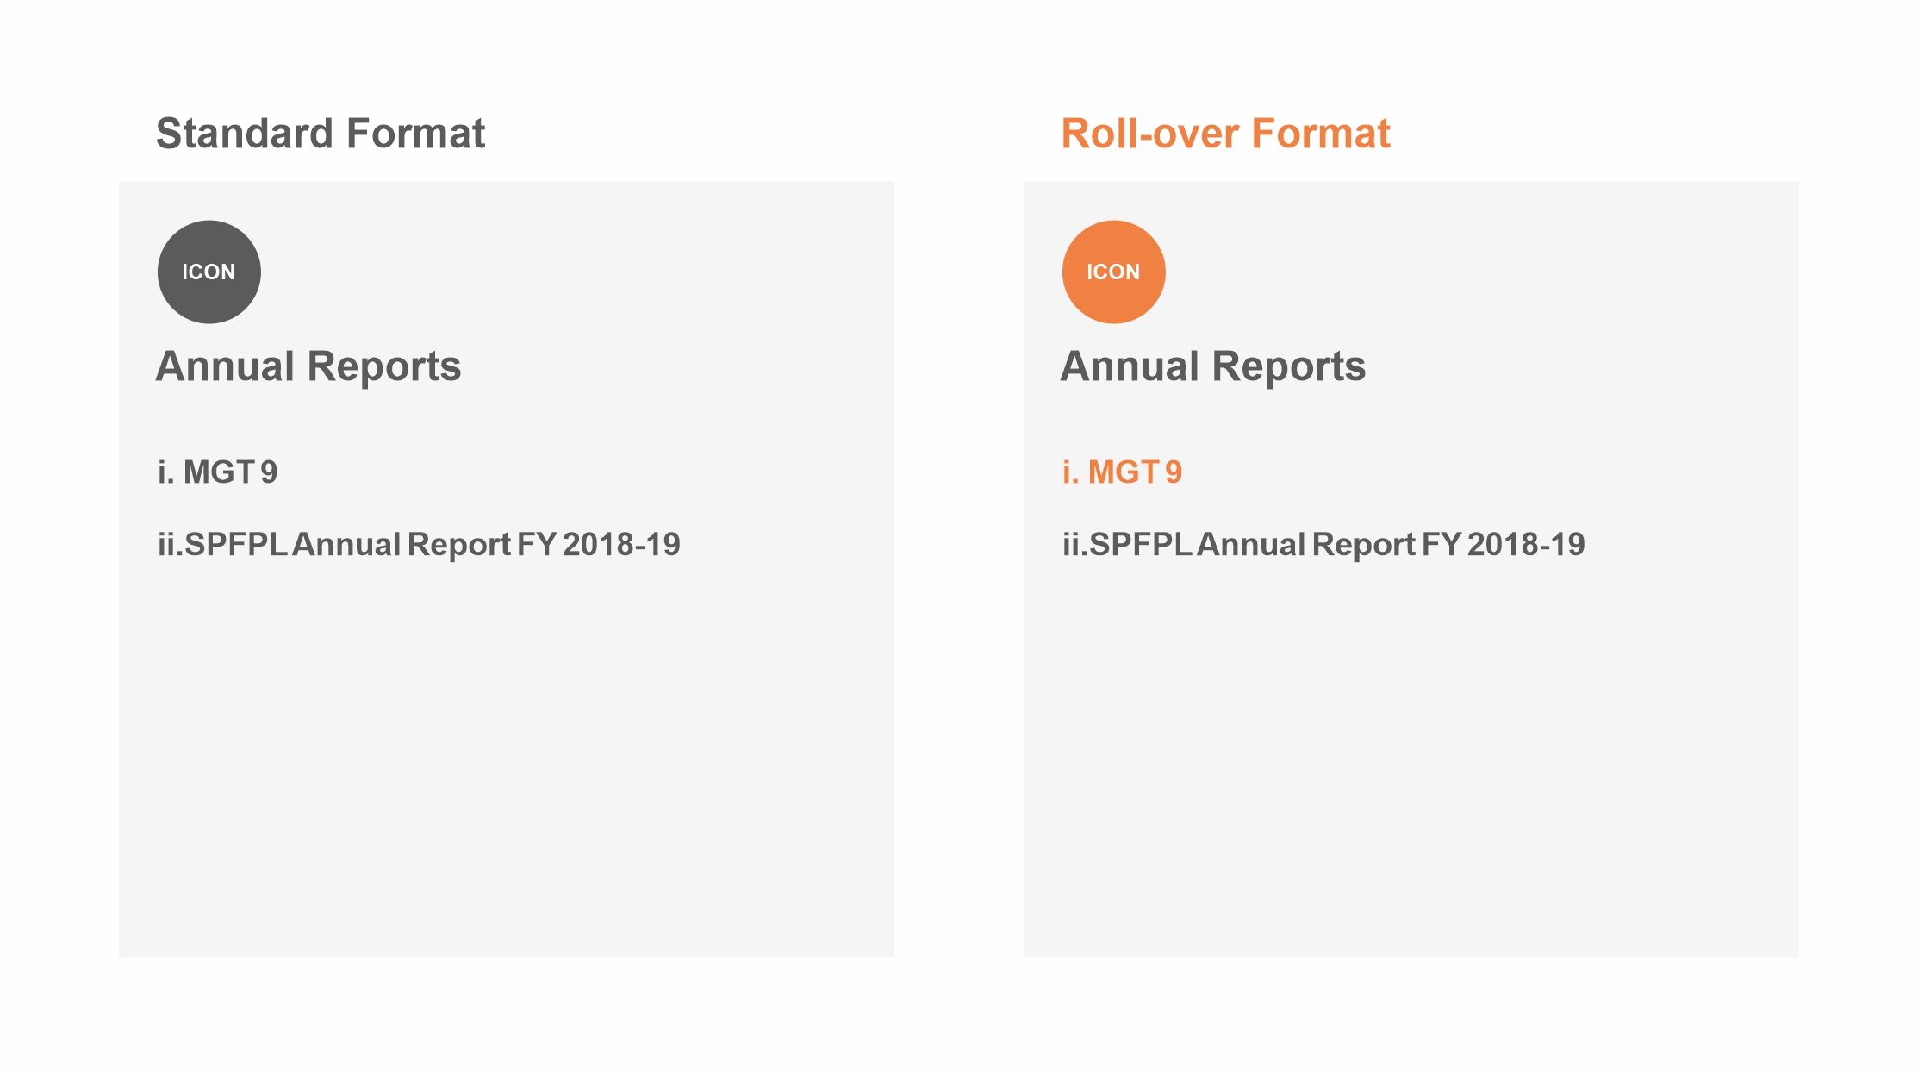
Note:
Kindly use a light gray background for all boxes but 10% darker than the base page colour. For example, if the base page colour is 10% Black, then the boxes colour will be 20% Black.
Kindly use ‘ICON’ which will relate to the respective Policies & Guidelines option.
When the mouse is placed over any of the respective item in any of the boxes, that particular item will turn orange along with the ICON.
When that item is clicked, a new window will open to display the respective PDF.
There will be no download of any document from the website.

Slide 4
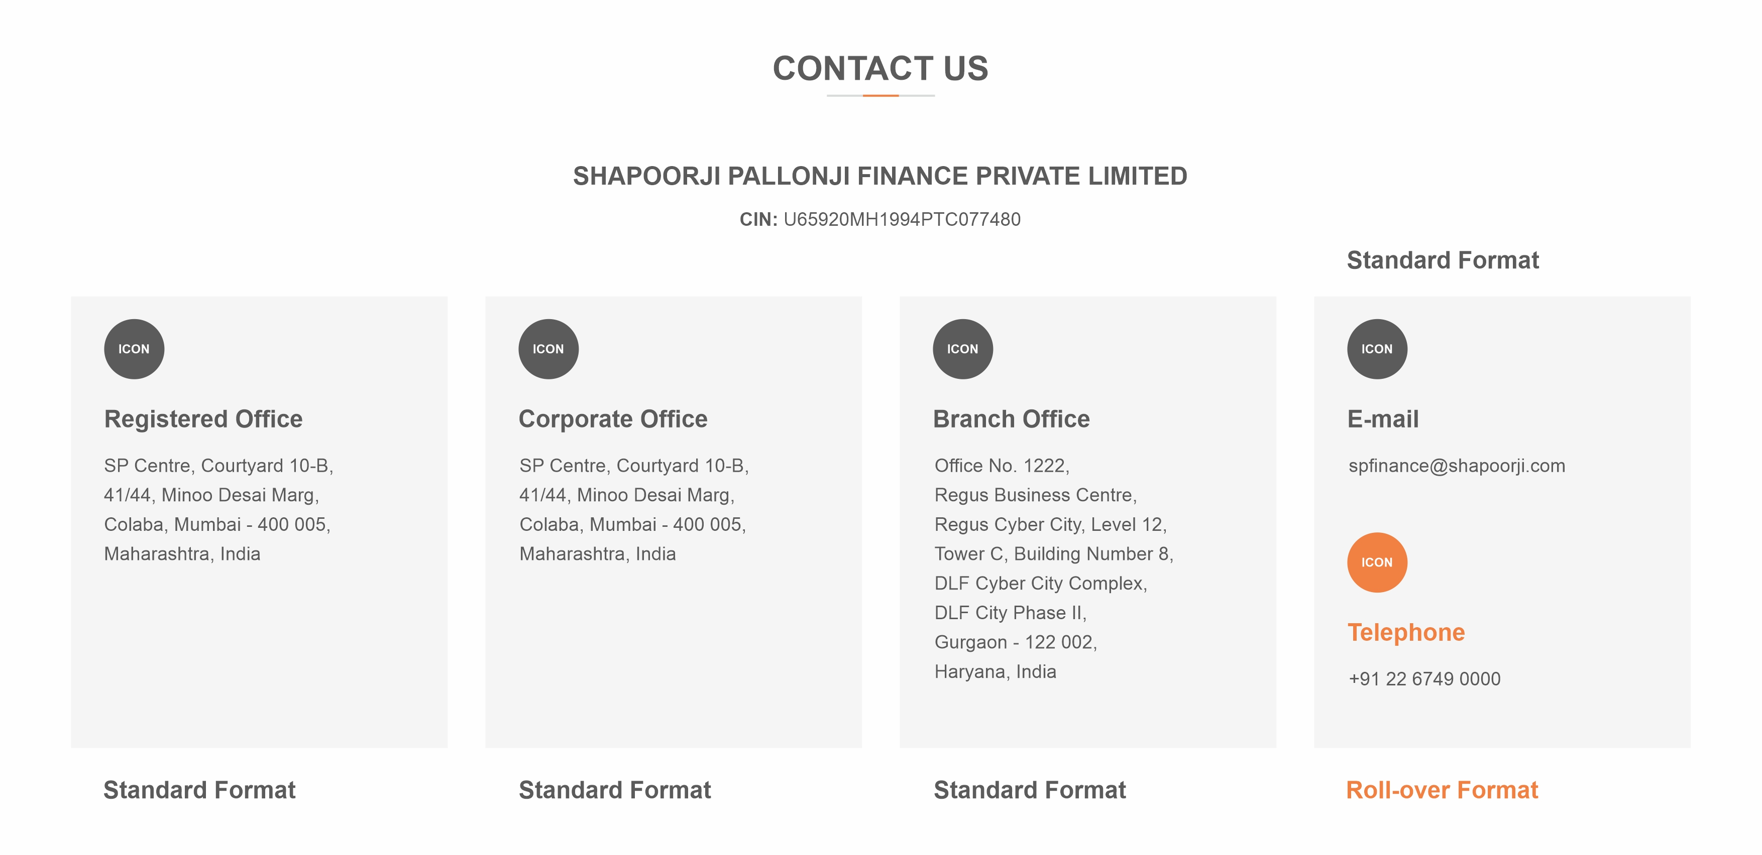
Note:
Kindly use a light gray background for all boxes but 10% darker than the base page colour. For example, if the base page colour is 10% Black, then the boxes colour will be 20% Black.
Kindly use ‘ICON’ which will relate to the respective Title.
When the mouse is placed over any of the respective Title in any of the boxes, that particular Title will turn orange along with the ICON.

